Slide 1
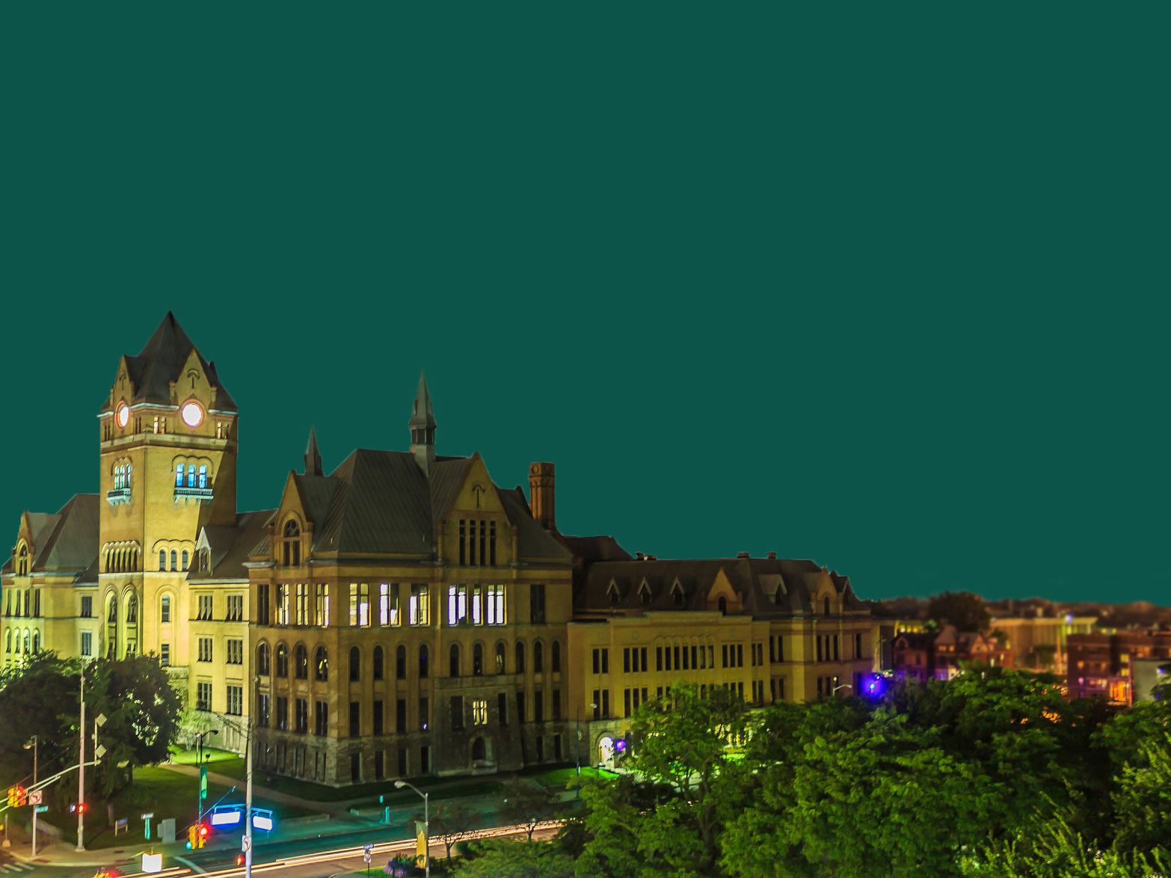
Strategic Planning
Fall 2014

Slide 2
Process
Steering Committee: S. Lanier, R. Nork, M. Winters and M. Wright
Membership: C. Waites, P. Lindsey, A. Ezzeddine, M. Brockmeyer, L. Romano, J. Dunbar, J. Schiavone, J. Sawasky, D. Strauss, N. Shangle, S. Sheng, E. Brammer, L. Smith, W. Raskind and F. Fotouhi
Consultants: The Barthwell Group

Slide 3
Work to date
Vision: WSU is recognized as a pre-eminent, public, urban research university known for academic and research excellence, success across a diverse student body, and impactful engagement in its urban community.
Mission: WSU’s mission is to create and advance knowledge, prepare a diverse student body to thrive, and positively impact the local and global communities.

Slide 4
Ensure Student Success
Students are our top priority, and we provide them with the tools and experiences that they need to succeed. To promote student success, Wayne State University (the “University”) supports students by: (1) progressively developing their knowledge and intellectual skills; (2) encouraging critical thinking; (3) anchoring learning in involvement with diverse communities and real-world challenges; (4) applying their knowledge and skills in new settings and to complex problems; and (5) encouraging timely progression to graduation. Academic excellence, innovative pedagogies, collaborative, interdisciplinary research, career preparation, global experiences, and deep engagement in cultural diversity within a dynamic, urban environment all create a “Distinctively Wayne” student experience.
Goals
Cultivate an institutional culture of student success in which the student experience is central
Create clear academic pathways that support progressive student success
Create a “Distinctively Wayne” student experience
Use data effectively to promote student success and degree attainment
Increase retention, progress to degree and graduation rates for all students
DRAFT

Slide 5
Enhance Teaching Excellence
Using proven, evidence-based, high-impact practices and culturally responsive and reflective pedagogies, increase levels of student engagement, learning outcomes, to promote greater academic performance and achievement.
Goals
Create a culture that values teaching excellence
Identify best teaching practices and the improved delivery of learning outcomes campus-wide through the use of data
Improve the quality of faculty-student relationships, within the classroom and beyond
Improve graduate student training and mentoring
DRAFT

Slide 6
Increase Strategic, Collaborative Research
Increase strategic, integrative research and nurture the broad ecosystem for scholarly inquiry, discovery and knowledge application leveraging our academic strengths, community engagement mission, and urban location.
Goals
Establish WSU as a world leader in discovery and knowledge application with a focus on the urban environment
Develop the infrastructure and processes necessary to support research, knowledge application and broad programmatic initiatives
Integrate research into the curriculum as a distinctive element of a Wayne State University education
DRAFT

Slide 7
Embrace Diversity and Inclusion
We strive to have an inclusive environment where diversity is valued broadly. We appreciate the ability of every person to contribute to our diversity of thought. We remain committed to improving the proportionate representation of groups which have historically suffered underrepresentation, and seek to close the racial educational achievement gaps. Our rich multicultural experiences enable us to develop exportable programs and curricula, which provide leadership in a multicultural society.
Goals
Leverage our diversity to create a diverse and inclusive campus where every group and individual feels valued
Implement and enhance academic programs focused on cultural, language, and global competencies
DRAFT

Slide 8
Drive Innovation & Entrepreneurship
We will enhance innovation throughout the University so that everyone embraces change and new ideas, is willing to take risks, and seeks a better way to accomplish their goals. We will translate research and development into innovation and entrepreneurship which will permeate our campus culture and enhance the growth and vitality of the University, Detroit, and the region.
Goals
Ensure that innovation and entrepreneurship are valued and rewarded
Simplify/coordinate/enhance the process of innovation and entrepreneurship
Build a comprehensive entrepreneurship training pipeline
DRAFT

Slide 9
Enhance Community Engagement
We encourage every faculty member, administrator, and student to participate in mutually-beneficial relationships with our community. Experiential learning and community service are vital to our academic mission.
Goals
Become more recognized as a leading partner in the economic revitalization of Detroit
Become a greater resource to selected community organizations aligned with our mission
Develop innovative, mutually-beneficial community-based service learning experiences
DRAFT

Slide 10
Ensure Financial Sustainability
To grow revenue and increase the efficiency and effectiveness of business processes in order to provide adequate resources to support the University’s mission while maintaining a value-based tuition structure.
Goals
Increase enrollment
Develop a culture of philanthropy throughout the University community
Grow research-based revenue to increase Indirect Cost Recovery (ICR)
Diversify and enhance sources of revenue
Achieve excellence in all operational processes
DRAFT

Slide 11
Role for campus
Visit the website: http://wayne.edu/strategicplan
Respond to requests for feedback
Attend the 9-10:30 a.m., November 11th town hall meeting in Bernath Auditorium, and participate.

