Slide 1
Wayne State University
Department of Athletics

Slide 2
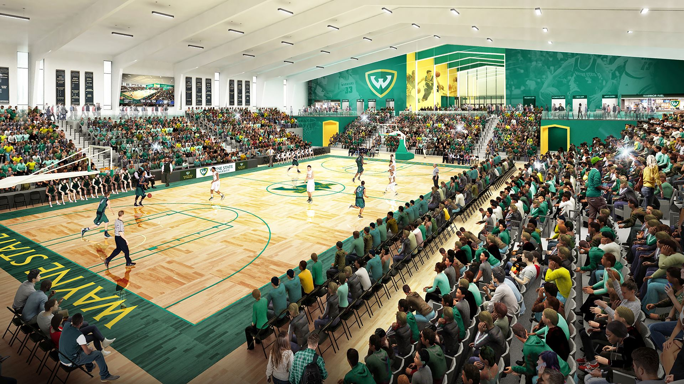
ABOUT THE ATHLETIC DEPARTMENT:
The Wayne State Athletic Department has 17 varsity sports with nearly 400 student athletes. Warrior Athletics also supports two Spirit Squads: Cheerleading & Dance.
WSU is part of the Great Lakes Intercollegiate Athletic Conference, GLIAC.
All of our sports programs compete Division II, with the exception of Fencing which competes Division I.
The Matthaei Building, the main athletic building on campus, was built during the 1960s by the Detroit Olympic Committee.
The Wayne State Athletic Department
is partnering with the Detroit
Pistons to build a new basketball arena
Set to open in 2021.

Slide 3
HOW CAN YOU GET INVOLVED?
WSU Students receive FREE admission to all home athletic events. Students scan into the game using the Corq app!
Students can earn PRIZES for attending games!
Game Day Parking is free in the Matthaei Parking Lot.
Students, parents, families, and organizations participate in tailgating activities prior to each home game. Giveaways and different activities are available throughout games.
Students can join the WarriorZone, the official student section of the Wayne State Warriors- for free. A VIP pass is available for upgrades and special events!
Visit WSUATHLETICS.com to purchase tickets, obtain sport schedules and results, learn about upcoming activities and to stay connected with us.

Slide 5
More about Athletics at Wayne State :
The Mort Harris Fitness and Recreation Center
- Free Student Admission
- Club Sports
- Intramural Sports
- Group Fitness Classes
- Updated equipment
- Personal Fitness Trainers
- Climbing Wall
- Adventure Programs
Other recreational activities available to students
- Tennis
- Pickleball
- Racquetball /Badminton
- Outdoor track
- Open swim
*All open recreation hours are listed on the Mort Harris website and change monthly.

Slide 7
The Wayne State Fight Song:

