Slide 2
Welcome to Wayne State
2022 Parent and Family Orientation

Slide 3
Today’s schedule
Morning
Afternoon
Family: series of informational presentations
Students: warm up and register for classes
Family and students together for lunch
Tours and information sessions

Slide 4
General Campus Safety information and Title IX reporting

Slide 5
Safety features of your campus
Wayne State Police Department (WSUPD)
313-577-2222
Blue-light emergency phones
Community policing
Campus Safety presentations
12:30 and 1:15 p.m. today, Student Center Ballroom

Slide 6
Title IX
No person in the United States shall, on the basis of sex, be excluded from participation in, be denied the benefits of, or be subjected to discrimination under any education program or activity receiving Federal financial assistance.
Under Title IX, discrimination on the basis of sex includes sexual harassment.

Slide 7
Title IX reporting
Any person may report sex discrimination, including sexual harrassment, in person, by mail, by telephone or by electronic mail using the following contact information.
Title IX Coordinator
Faculty Administration Building, Suite 4249
656 W. Kirby
Detroit, MI 48202
313-577-9999
TitleIX@wayne.edu
titleix.wayne.edu

Slide 8
Academica overview

Slide 9
FERPA

Slide 10
Family Educational Rights and Privacy Act
Gives students the right to:
inspect and review their education records
request that the institution correct education records that the student believes are inaccurate or misleading
control the disclosure of the student's education records
FERPA Acknowledgement Form > a.wayne.edu > type FERPA in the search bar

Slide 11
Coming up next at Orientation

Slide 12
Student Support Services
University Advising Center, Academic Success Center, Career Services

Slide 13
Advising & Your Student
Notes:
Introduction
Presenting on behalf of all advisors at WSU

Slide 14
The Family Educational Rights & Privacy Act (FERPA)
Applies to all students
Even if under 18
Even if someone else pays tuition
Prevents release of student information
Bills
Grades
Advising
Discuss waiver with your student
https://doso.wayne.edu/parent-family/resources
Notes:
The Family Educational Rights & Privacy Act
AKA Ferpa
Big shift for parents – No longer automatically informed of things that are going on with your student
There is an “Authorization to Release Academic Records”
Discuss with your students

Slide 15
Advisors At Wayne State University
Ally and resource for your student
Course planning
Professional development
Campus engagement
Degreeworks, STARS
Every semester
If we do not know the answer, we will find someone who does!
Notes:
WSU has assigned advisors in majors, minors, special programs
Also has supplemental advisors – pre-health
We are a resource throughout their academic journey in many regions including planning classes, creating connections on the campus, etc.
An academic advisor has already reached out to your student, providing course recommendations and answering any follow up questions
We want students to connect with us too – Find assigned advisor on Degreeworks, and use STARS
Expect to meet once a semester, starting this fall

Slide 16
What’s in a degree?
3 Components:
120+ credits
Major, possibly minor, honors, etc.
General Education
Competencies & Inquiry Areas
Notes:
++Animations++
Every degree at WSU has these 3 things
Minimum of 120 credits – some students do have more at graduation
Major – deep area of study and specialization
Some students will also have a second major, or minor, or honors college requirements, or will be working on classes for a professional pathway like medicine
General education – broken into two types: competencies (skills that all college educated students should master like English, math and public speaking) and Inquiry Areas (topics that add breadth to the degree)
Ged ed helps your students diversify their skills and areas of knowledge beyond their major; create a foundation for life long learning; can help an undecided student explore possible majors; build transferrable skills valued by employers like strong written and oral communication, problem solving, strong work ethic

Slide 17
What to expect on your student’s schedule
12-15 credits made up of:
Wayne Experience
English and/or Math
1-2 General Education course
1-2 Possible Major courses
All courses will have a purpose
Notes:
Some of your students may have registered before today
Majority of them will be spending time this am working with advisors to get their fall schedule organized
This is what a typical schedule will look like
They are beginning to build their relationship with an advisor, creating connections that will support their strong transition to WSU in the fall
IF they reach out today to ask you questions – What should I take – Please remind them that there are people to help, to ask an advisor or Orientation leader for support
If your student expects to receive AP/IB/Transfer credit – please understand that they should register as directed today and change later after results are in
There is time in the afternoon to Ask an Advisor. This is a chance for quick questions about schedules, next steps, clarifications. Advisors are available throughout the summer answering emails

Slide 18
How to Support Your Warrior
Notes:
Express your love – be there for them, remind them that you support them no matter what
Say "That sounds tough. Is there anything I can do to help?"
This approach gives your student space to vent if that's all they need
It also gives your students the responsibility for the problem-solving
Remember – they are emerging adults – need to learn to do this!
Reframe situations – help to make perspectives positive if needed
Encourage a big picture view – help your students see situations in the larger context, provide them with examples of challenges they have overcome before
Guide problem solving, don't do it for them – ask questions to help your student ID the problem, develop a list of pros/cons of possible solutions, remind them of resources available both on and off campus if needed

Slide 19
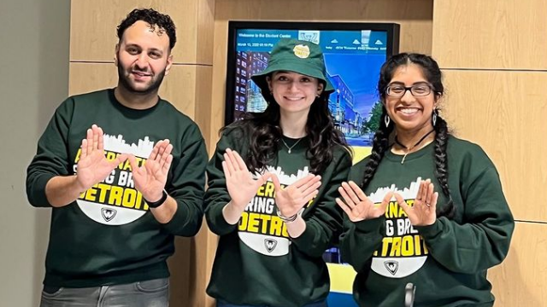
Thank you!
Enjoy the day

Slide 20
Academic Success Center

Slide 21
Career Services

Slide 22
Let's take a break

Slide 23
Health and Wellness
Counseling and Psychological Services, Campus Health Center, Student Disability Services, Warrior Life

Slide 24
Mental Health Services
Counseling and Psychological Services (CAPS)
Free, private, & confidential counseling to WSU students
Individual, group, and couples
In-person and telehealth services
Psychiatric services
Outreach
Presentations
Let’s Talk
Support groups
Workshops
Referrals

Slide 25
Accessing Services
5th floor student center building
Office Hours
8:30AM – 5PM
Initial Consult
1st step with services at CAPS
Schedule an IC online that fits your schedule
M-F, 9AM-3:30PM
45-60 minutes
Computer assessment & chat with a counselor

Slide 26
Need Additional Support?
Visit our website at www.caps.wayne.edu
Call CAPS (313) 577- 3398
Protocall Afterhours
(After 5pm and weekends)
313-577-9982

Slide 27
101

Slide 28
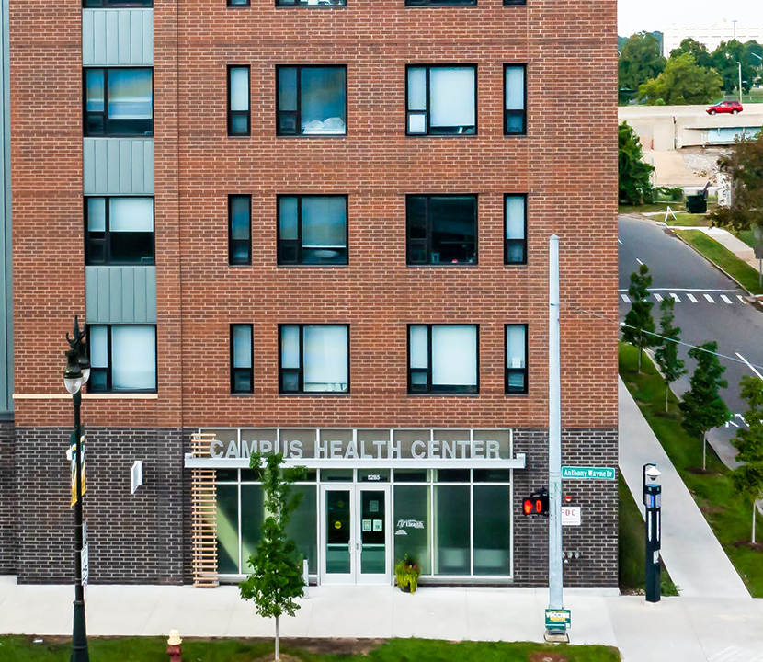
Campus Health Center
Full-service primary care clinic
Serving enrolled WSU students
Nurse-managed clinic owned and operated by Nursing Practice Corporation (NPC), the faculty practice plan of the College of Nursing (CON) at WSU

Slide 29
Illness Care
ACUTE
Flu-like illness
Fever
Sore throat
Cough
Runny nose
Stomachache
Bites/stings
Rashes
Infections
Sprains and strains
UTI
CHRONIC
Asthma
Diabetes
High blood pressure
One free illness visit per semester!

Slide 30
Preventive Care
Immunizations
Hepatitis A, B
Influenza
COVID-19
Other routine immunizations
Travel Health
Pre-travel consultation
Vaccinations
Medications
Post-travel follow-up
TB Testing
TB skin tests
T-spot blood tests

Slide 31
Routine Health Care
Routine Wellness
Physicals
Allergy injections
Store allergy serum
Clearance exams
Wellness Exams
Women’s wellness
Pap smear
Birth control
Men’s wellness
Sexual Health, Testing & Treatment
HIV testing
Testing and treatment for other STIs
PrEP (Pre-Exposure Prophylaxis)

Slide 32
Behavioral Health Care
Mental health screening and assessment
Individual counseling
Group counseling
Education
Connection to resources

Slide 33
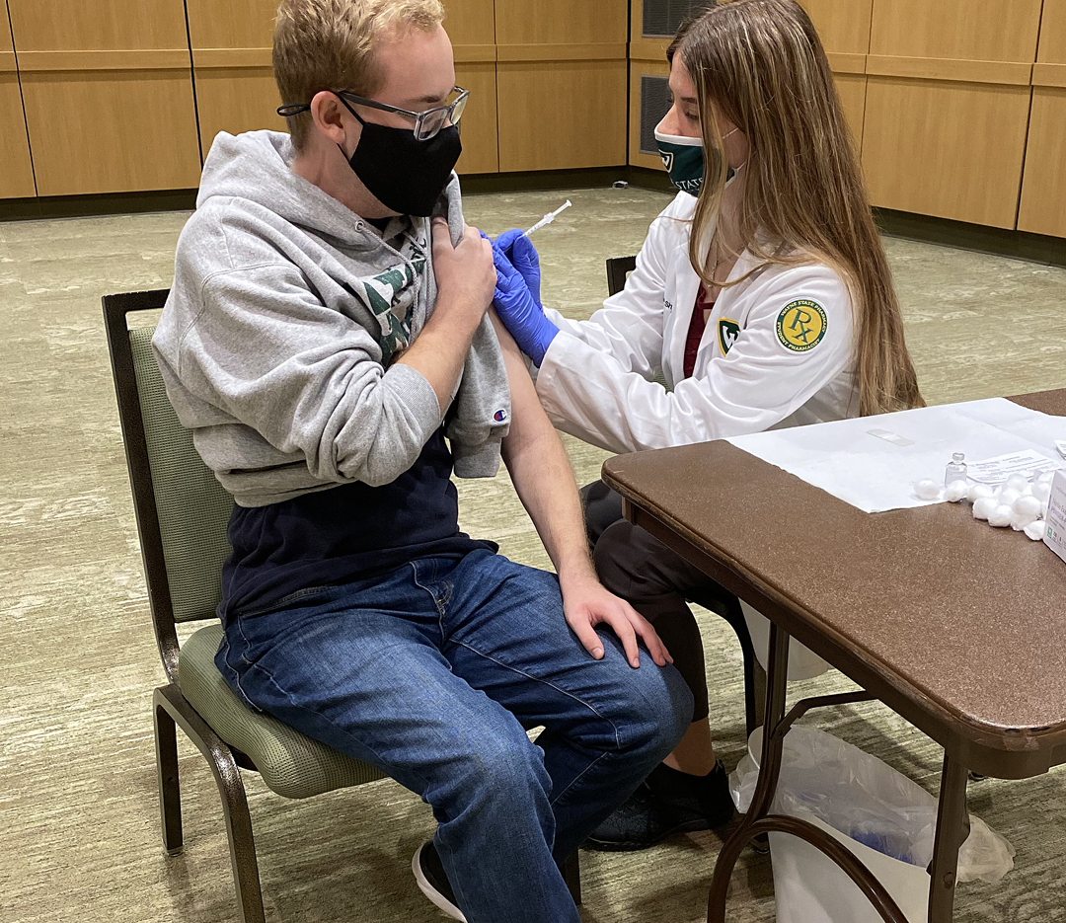
Outreach and special programs
Flu Vaccine Clinics
COVID Booster Clinics
Condom Club
Get Yourself Tested (GYT)
Let’s Talk
Weekly drop-in, free mental health consultations with licensed therapist
Confidential, accessed by Zoom link

Slide 34
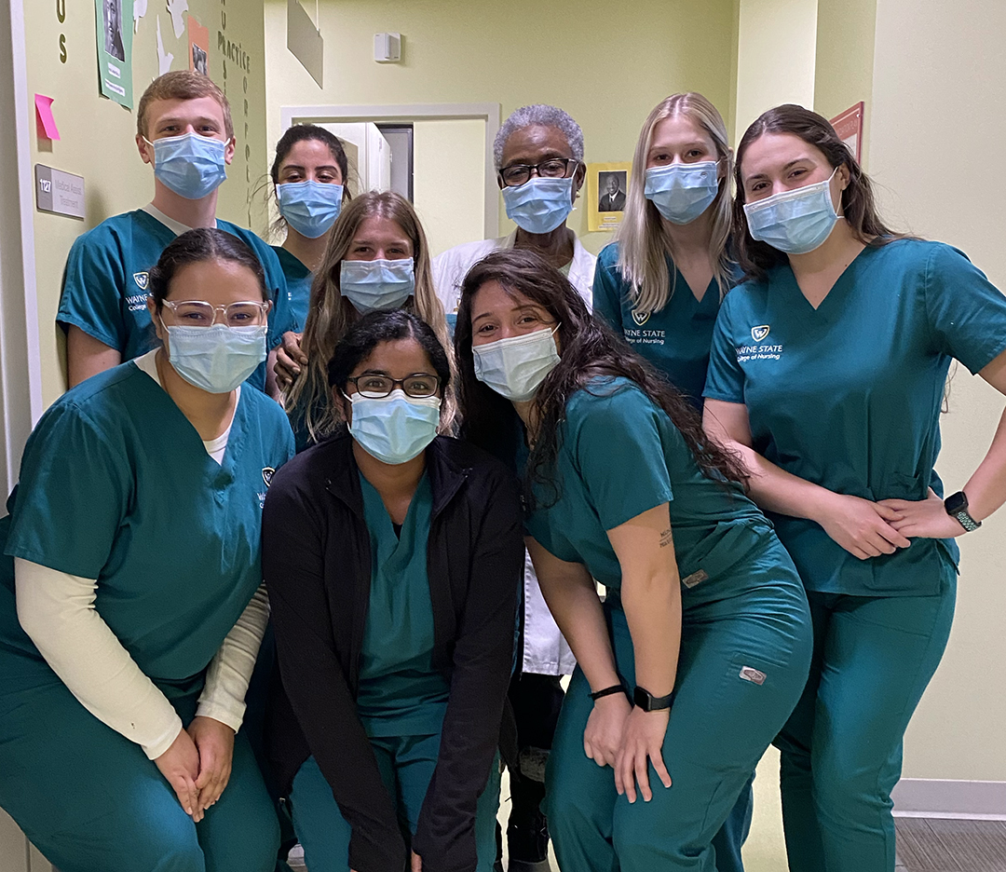
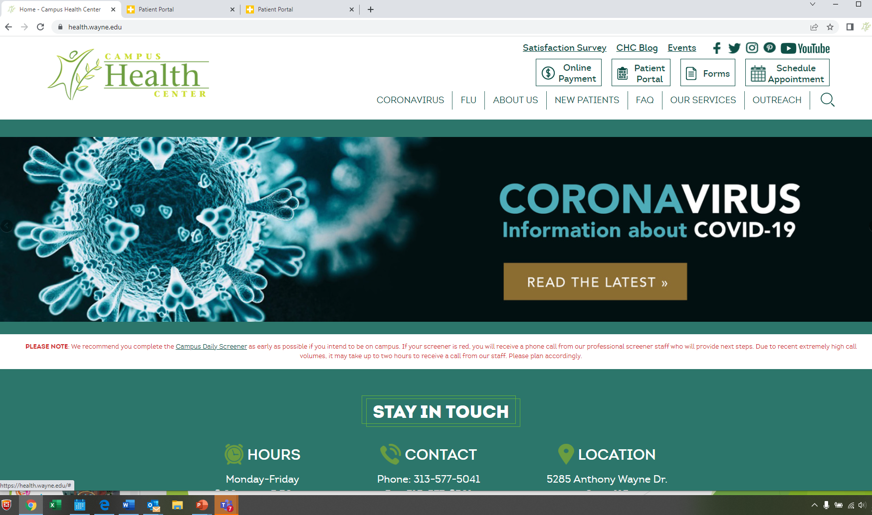
Patient Portal
Test results
Pay bills
Request records

Slide 35
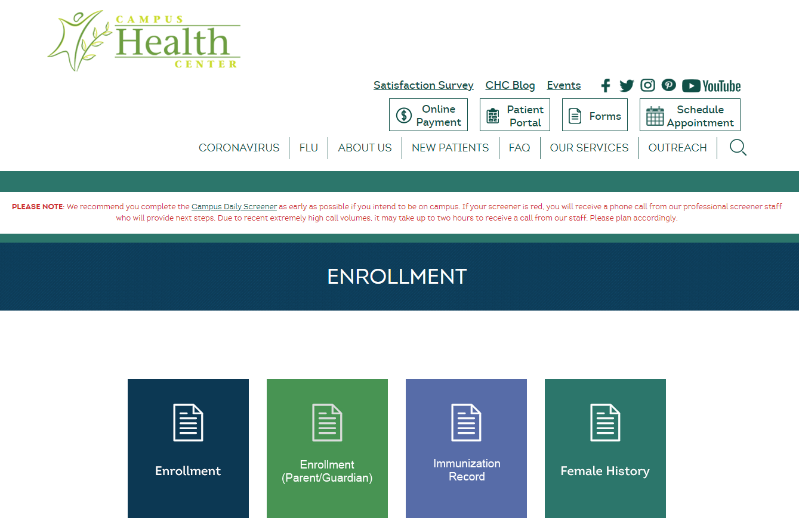
Minor Consent Form
Parent or guardian consent is required for most routine medical care in Michigan for students 18 years or younger.
If your student will be 17 or younger when arriving on campus, please complete and return the Minor Consent Form.

Slide 36
Location:
5285 Anthony Wayne Dr. Detroit, MI 48202
Hours:
Monday though Friday
9 a.m. - 5:30 p.m.
Schedule appointments:
Online: health.wayne.edu
Phone: 313-577-5041
Follow us socially:
Instagram: @campushealthcenter
Facebook: /campushealthcenter
Twitter: @wsucampushealth

Slide 37
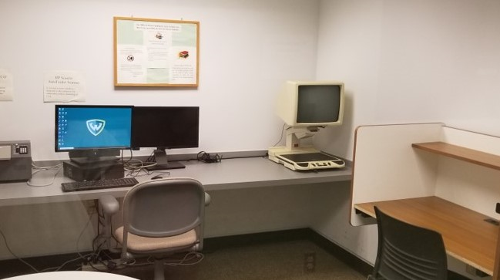
STUDENT DISABILITY SERVICES
wHERE ACCESS AND SUCCESS ARE POSSIBLE
David Adamany Undergraduate Library, Suite 1600

Slide 38
ABOUT US
•Ensure academic access and inclusion in all aspects of university programming
•ADA federally-compliant office: ADAA (2008), Sections 504 and 508 of the Rehabilitation Act (1973)

Slide 39
Who we serve
•Attention Deficit/Hyperactivity Disorders
•Psychological and Psychiatric Disorders
•Blindness/Visual Impairments
•Deaf/Hard of Hearing
•Learning and Cognitive Disabilities
•Medical Conditions
•Physical Disabilities
•Temporary Disabilities

Slide 40
What is an accommodation?
The term "accommodation" describes an alteration of environment, curriculum format, or equipment that allows an individual with a disability to gain access to content and/or complete assigned tasks. They allow students with disabilities to pursue a regular course of study.
Examples of accommodations include:
interpreters for students who are deaf;
computer text-to-speech computer-based systems for students with visual impairments or Dyslexia;
extended time for students with fine motor limitations, visual impairments, or learning disabilities; and
large-print books and worksheets for students with visual impairments
SDS will not issue accommodations that alter the essential requirements of a course or program Students with disabilities admitted to the university have met the same standards for admission as all other students.

Slide 41
How to register
https://wayne-accommodate.symplicity.com/public_accommodation/
After completing the online registration form, you will receive a phone call to schedule an intake appointment.
Students must provide documentation of their disability, which can be uploaded to our online system or emailed to us at studentdisability@wayne.edu
You will be assigned to a Disability Specialist for services and support.
Students must request updated accommodation letters every semester and provide them to their instructors.

Slide 42
Dean of Students Office

Slide 43
Basic Needs
The W Food Pantry and Wardrobe
Registered students can visit twice a month for food
Students can visit once a month for clothing
Feminine hygiene items any time
Offers:
Supplemental food assistance
Basic needs connections to MDHHS
Clothing
Small appliances and kitchenware
Transportation assistance
Qline, MOGO, Public Transportation
Notes:
Ryan

Slide 44
Comprehensive Health and Wellness on Campus
Chief of Health and Wellness
Coordinated Care Approach
Counseling and Psychological Services
In-person crisis management
Campus Health Center
Covid, Flu vaccines
Code of Conduct
Rights and Responsibilities of students
Title IX Office
360 Service
Student Compliant Form
Ask a question on DOSO's website

Slide 45
Contact us
Dean of Students Office
301 Student Center Building doso.wayne.edu doso@wayne.edu / getinvolved@wayne.edu 313-577-1010
Kenya Maxey
Ae4082@wayne.edu
313.577.2743
Notes:
Heather

Slide 46
Money Matters
Office of Student Financial Aid, Student Accounts Receivable, Student Service Center

Slide 47
Office of Student Financial Aid

Slide 48
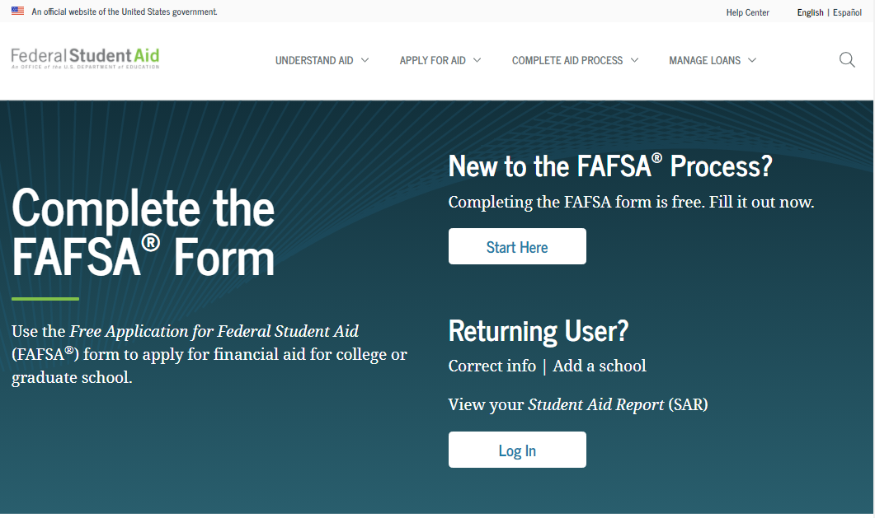
By now students should have already…
Completed the 2022-23 Free Application for Federal Student Aid (FAFSA)
Made any necessary corrections to the FAFSA
Reviewed Academica for financial aid updates
Submitted any additional documents to our office

Slide 49
It’s not too late….
You can still complete the FAFSA at studentaid.gov/fafsa
or add WSU to the FAFSA - 002329
Check the Financial Aid Portal in Academica for award status and any other requirements that are needed
Get those documents in ASAP!

Slide 50
In Academica
On the left side of Academica, under “Student Resources”, click the “Financial Aid” link to see the link to access the “Financial Aid Portal”
When you enter the “Financial Aid Portal”, you will be able to click tabs where you can do the following:
Fulfill requirements
Accept your awards
Check messages from financial aid

Slide 51
Info for new Warriors…
We encourage students and their families to estimate their own educational costs and to make a plan if they need additional funding
If students want to borrow loans, they have to accept them in the Financial Aid Portal
First time borrowers must complete Entrance Counseling and a Master Promissory Note
There are annual and lifetime limits to the amount of Pell Grant students can receive and loans they can borrow
Once the semester begins, students will need to be confirmed in courses prior to aid disbursing
If your student begins to struggle academically, encourage them to check in with their Academic Advisor to develop a plan
Warrior $mart is the place to go for students to grow in their financial literacy knowledge
We are here to help, anytime you have a questions, please ask!

Slide 52
How to contact us
Email Us
studentservice@wayne.edu
Call Us
313-577-2100
Visit Us in the Welcome Center
42 W. Warren
Detroit, MI 48202
Monday through Friday, 9 a.m. to 5 p.m.
For general financial aid information, visit us at
wayne.edu/financial-aid
For more information regarding scholarships, visit us at
wayne.edu/scholarships/

Slide 53
Student Accounts Receivable

Slide 54
The Office of Student Accounts Receivable
Handles student accounts and billing inquiries
Collects outstanding tuition and loans receivables
Oversee Student Refund distribution
Processes third-party tuition sponsorships
Phone: 313-577-3653
Email: bursar@wayne.edu

Slide 55
Federal Education Rights & Protection Act (FERPA)
Parent/Guardian Record Release Authorization
1. Your student can go to wayne.edu and type “FERPA form” in the search engine at the top right side of the website
2. Click “Forms – Office of Registrar”
3. Select “Release Academic Records (FERPA)” to authorize parents/guardians

Slide 56
E-bill
The E-bill is an official monthly statement sent electronically and can be viewed by the student on Academica
Since Wayne State University is paperless, e-bills can only be accessed via the student portal:
E-bills are static - statements are updated at the beginning of each month
*Paperless Billing Only*

Slide 57
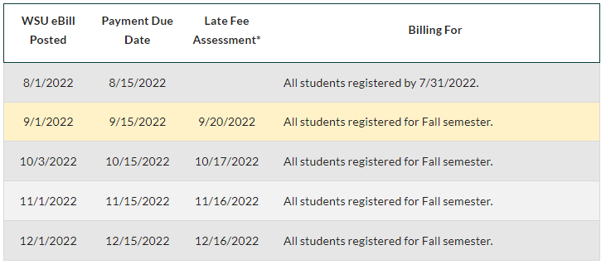
Due dates are found online at wayne.edu/bursar/ebill/ebill-schedule/
DUE DATES
Fall 2022

Slide 58
Payments
Parent Pin: to pay online, your student will need to create a Parent Pin for you. For information, visit wayne.edu/bursar/parent-pin-setup
Pay with Fee-Free electronic check, or by credit card. Please be advised there is a 2.99% convenience fee for online credit card payments.
Pay by mail - checks, money orders and cashier checks can be mailed to:
WSU Cashier's Office P.O. Box 02788 Detroit, MI 48202

Slide 59
Installment Payment Plans
Wayne State University offers 5-month, 4-month and 3-month payment plans each semester, with enrollment beginning in July.
Payment Plans can be accessed via Academica. Information about 2022 Fall Semester payment plans will be published soon. Check wayne.edu/bursar/payment/installment-plans for updates.

Slide 60
MESP (529 Accounts) & MET
Log in to your 529 account
2. Request payment be mailed to: Wayne State University P.O. Box 02788 Detroit 48202
*Include Student ID in the memo section
Contact MET and add Wayne State University to your contract and our office will take care of the rest
MET does not cover all fees; be sure to check your e-bill

Slide 61
Student Service Center

Slide 62
What is the Student Service Center?
The SSC is the first-stop for answers to questions from students, parents/families and anyone interested in Wayne State University.
We engage with students across three platforms:
Walk-in conversations
Email exchange
Phone conversations
We provide first-level support to students for the following offices/services:
Undergraduate Admissions
Records and Registration
Office of Student Financial Aid

Slide 63
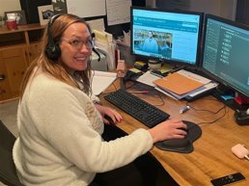
What can students expect when contacting SSC?
Specialists are cross-trained in the areas of financial aid, undergraduate admissions, and records and registration to assist with frequent questions.
Specialists attempt to answer questions and solve problems.
Specialists escalate cases for same day follow-up when needed.
Specialists track all interactions with students via case management system.

Slide 64
Contact us
Student Service Center and Office of Student Financial Aid
studentservice@wayne.edu
313-577-2100
Student Accounts Receivable
bursar@wayne.edu
313-577-3653
Located on the first floor of the Welcome Center.

Slide 65
Coming up...

Slide 66
Welcome to Wayne State!

