Slide 1
Gen Ed Assessment in CI AND GL: Selecting Assignments, Using the Canvas Rubric
Jennifer Hart, Associate Professor of History, Co-chair of GEOC
jennifer.hart4@wayne.edu
Cathy Barrette, WSU Director of Assessment
on behalf of the GEOC Assessment Subcommittee
c.barrette@wayne.edu
AY21-22

Slide 2
Overview
Goals of Gen Ed assessment
Instructor responsibilities
Example: Cultural Inquiry (CI) and Global Learning (GL) learning outcomes and rubric
Selecting assignments
Using the Gen Ed rubric in Canvas
Non-rubric scoring
Where to get help

Slide 3
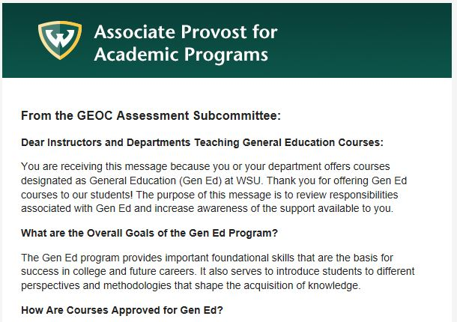
WSU’s Context for Gen Ed Assessment
See the General Education Oversight Committee’s email or the Gen Ed assessment website for more information

Slide 4
Initial Development of Gen Ed Assessment
Form team (W18)
Research models
Draft rubrics
Committee pilot
Revise
Technology pilot
Launch (F19)
NILOA coach
AAC&U conference
Stakeholder pilot
Revise
GEOC rubric approval
GEOC initial approval
Consult with IR
Timeline
Notes:
Research, PD for asmt subcommittee (AAC&U conference)
Broad approach approval from GEOC
NILOA coach
Drafting, revising, committee piloting
Feedback from faculty and staff experts in content areas
Feedback from student senate
Piloting with actual assignments
Revision
Approval from GEOC
our General Education assessment committee has undertaken a staged development and implementation process that has invited faculty, staff, and students to learn about General Education assessment, participate in the development and piloting of rubrics for multiple General Education focus areas, and provide feedback about the supporting processes and structures. These efforts have drawn on support from internal and external resources to build institutional capacity for General Education assessment, including committee members’ attendance at an AAC&U conference on General Education assessment, a campus visit from a NILOA coach who offered workshops on rubric development for three of our General Education focus areas, meetings with relevant General Education working groups, and ongoing assessment workshops offered by Wayne State’s Office for Teaching and Learning. Careful attention to open communication from faculty leaders to General Education stakeholders has also been a key element at each step of the process.

Slide 5
Instructor Responsibilities (Fall and Winter)
Design syllabus
Course description
Gen Ed learning outcomes and rubric
Select assignment(s)
1 or more
Which best elicit evidence of each Gen Ed LO?
Score with Gen Ed rubric
Used as assessment data, separate from grade for student
Canvas submissions preferred
Incorporate:

Slide 6
Some Definitions
Learning outcomes are statements that describe what students should know or be able to do.
Gen Ed outcomes are set by the General Education Oversight Committee (GEOC).
Rubrics are scoring tools that describe different levels of performance on each learning outcome.
Course assignments are activities that elicit student performance, such as tests, projects, presentations, homework, and more.
A Canvas assignment is a digital placeholder for your course assignment.

Slide 7
CI Rubric Glossary
Artistic or Humanistic Analysis: methods of evaluation and assessment in arts and humanities disciplines
Artistic Practice: the ways in which an artist goes about his/her work; can include the activities involved in producing artistic objects, performances, influences, ideas, and materials as well as tools and skills
Cultural Form: concrete manifestations of culture; observable entities through which members of culture express, affirm, and communicate cultural substance to one another.
Artifact: an object made by a human being, typically an item of cultural or historical interest
Philosophical Idea: concepts or theories that are the subject of philosophical inquiry and debate

Slide 8
Gen Ed Rubric Example
CI Learning Outcomes | High | Moderate | Low | Little to No Evidence
LO1: Explain basic concepts in artistic or humanistic analysis. | Applies different concepts in artistic or humanistic analysis. | Explains basic concepts in artistic or humanistic analysis. | Identifies basic concepts in artistic or humanistic analysis. | Unable to identify basic concepts in artistic or humanistic analysis.
LO2: Analyze an artistic practice, cultural form, artifact, or philosophical idea. | Interprets an artistic practice, cultural form, artifact, or philosophical idea. | Analyzes elements of an artistic practice, cultural form, artifact, or philosophical idea. | Describes an artistic practice, cultural form, artifact, or philosophical idea. | Unable to identify an artistic practice, cultural form, artifact, or philosophical idea.
LO3: Compare artistic practices, cultural forms, artifacts, or philosophical ideas | Interprets similarities and differences across multiple artistic practices, cultural forms, artifacts, or philosophical ideas. | Compares similarities and differences across multiple artistic practices, cultural forms, artifacts, or philosophical ideas. | Identifies different types of artistic practices, cultural forms, artifacts, or philosophical ideas. | Unable to identify different artistic practices, cultural forms, artifacts, or philosophical ideas.
A “not submitted” column is also included in your Canvas rubric.
Levels are implicational

Slide 9
GL Rubric Glossary
Social/economic/cultural/political phenomena: occurrences or situations that influence an individual’s or society's behaviors, opinions, etc.
Global Context: circumstances, locations, cultural movements, or economic systems that extend beyond the U.S.
Worldview: an individual’s or society’s particular philosophy of life or conception of the world
Multiple Worldviews: various philosophies of life or conceptions of the world that exist within a particular society or across different societies

Slide 10
Gen Ed Rubric Example
GL Learning Outcomes | High | Moderate | Low | Little to No Evidence
LO1: Explain social, economic, cultural, and/or political phenomena in a global context. | Evaluates explanations of social, economic, cultural, and/or political phenomena in a global context. | Explains social, economic, cultural, and/or political phenomena in a global context. | Identifies social, economic, cultural, and/or political phenomena in a global context. | Unable to identify social, economic, cultural, and/or political phenomena in a global context.
LO2: Explain how worldviews are shaped by differing historical, scientific, and/or cultural contexts | Analyzes the same historical, scientific, or cultural concept or phenomenon from multiple worldviews. | Explains how differing historical, scientific, and/or cultural factors or contexts shape people’s worldview. | Identifies factors or contexts that shape worldviews. | Unable to identify factors or contexts that shape worldviews.
LO3: Relate their worldview to those in communities outside of the US. | Evaluates the factors or contexts that contribute to differences in those worldviews. | Relates their worldview to those in communities outside of the US. | Identifies their own worldview and those in communities outside of the US. | Unable to identify their own worldview and/or those in communities outside of the US.
A “not submitted” column is also included in your Canvas rubric.
Levels are implicational

Slide 11
Selecting Assignments for Gen Ed Assessment
Summative assignments, not formative assignments
Think about the instructions for the course assignments on your syllabus or the sections/questions on your tests and quizzes. Which ones ask students to perform the behaviors in each outcome? Create a map or blueprint:
 | HW4 | HW 5 | Final Exam
LO1 | - | #1-4, 7-10 | Section 4, part B
LO2 | All | All | Sections 1, 3
Of the course assignments that you mapped to each learning outcome, which elicit at least the “Moderate” level of performance on the Gen Ed rubric?
You may need to consider tweaking a course assignment to elicit that level.

Slide 12
Samples for CI LOs
Example 1: multiple choice question
Engravings like Schongauer’s Saint Anthony Tormented by Demons were appealing to artists for several reasons. What was NOT one of them?
a. they were lightweight and portable
b. they were one-of-a-kind, unique works
c. they allowed artists to show off their drawing skills
d. they could reach a very wide audience
Example 2: discussion board question
Name one memorable design feature from the Dome of the Rock that was discussed in Lecture 2.1 and explain how it relates to the monument’s historical, cultural, or functional significance.
Example 3: essay question
Answer the following prompts for this painting: Manet’s Luncheon on the Grass, 1863
• Look at the image and describe the narrative: What’s in it and what’s happening?
• What is the overall mood or tone?
• Identify the presence and use of key formal artistic elements and principles. Describe their stylistic qualities.
LO 1: Explain social, economic, cultural and/or political phenomena in a global context.
LO2: Explain how worldviews are shaped by differing historical, scientific, and/or cultural contexts.
LO 3: Relate their worldview to those in communities outside of the US. [purple italics]

Slide 13
Sample for CI LOs
Write your own ballad adaptation of the Lear story, which should be approximately 100 lines in length. See [website] for more about ballad meter, woodcuts, and print; you may also want to search the ballad archive for additional models for your creative work. Your ballad must be based on Shakespeare’s Lear and at least one of these sources, which are available at Digital Texts:
The anonymous play Leir
Holinshed’s Chronicles
Spenser’s Faerie Queene (Book II, Canto X, Stanzas 27-32)
Sidney’s Arcadia (Book 2, Chapter 10)
Your ballad should be accompanied by a short reflective paper of five pages that details your creative practices. You should discuss the following issues:
How did you handle ballad meter, rhyme, and other formal elements?
Which version(s) of the Lear story did you choose as your sources and why?
What elements of the Lear story did you highlight or adapt in your work?
How do your changes to the story influence characterization, plot, and/or theme?
Your project should convey your own original thoughts; you should not repeat our class discussions in your essay. I will be happy to look over drafts during my office hours or by appointment.
LO 1: Explain social, economic, cultural and/or political phenomena in a global context.
LO2: Explain how worldviews are shaped by differing historical, scientific, and/or cultural contexts.
LO 3: Relate their worldview to those in communities outside of the US. [purple italics]

Slide 14
Sample for GL LOs
Essay instructions
Using assigned readings from Module 1 and the editorials linked below, analyze the film Black Panther as a representation of Africa. Who is the audience for the film and how does that shape the way that the film portrays Africa? What kinds of stereotypes does the film utilize and why? What kinds of images of Africa does the film portray? To what extent does the film challenge stereotypes of Africa? Identify examples - how might these examples transform the way thatwe understand Africa? What kinds of questions does the film raise for you? For the general viewer? How and why might African audiences view it differently? How might we use this film to engage audiences in learning?
LO 1: Explain social, economic, cultural and/or political phenomena in a global context.
LO2: Explain how worldviews are shaped by differing historical, scientific, and/or cultural contexts.
LO 3: Relate their worldview to those in communities outside of the US. [purple italics]

Slide 15
Assignment Selection Reminders
Your assignment(s) must elicit at least the moderate level.
The levels of rubric are implicational, so assignments that elicit the moderate and high levels can typically capture performance at the lower levels as well, which is ideal.
The assignment(s) should be selected from ones given toward the end of the semester to reflect the full sum of your students’ learning rather than only part of it.

Slide 16
After today’s workshop: Score Sample Responses
Try using your Gen Ed rubric to score former students’ responses. Comparing examples of actual students’ responses can help differentiate performance across the rubric’s levels and identify needed adjustments to the assignment’s design.
As you review student samples, ask yourself:
Do students actually perform or demonstrate the learning outcomes that the assignment was meant to elicit?
If not, what modifications to the assignment (or what other assignment) might work better?
What kind, amount, or quality of information differentiates a response at the high level from the moderate level? What differentiates moderate from low?
Notes:
https://waynestateprod-my.sharepoint.com/:w:/g/personal/aa1471_wayne_edu/EcJjC4-99qtEh4pmzNHg_88B4aQhso9MsWcClt7WhZOq1A?e=E3aVaj

Slide 17
Using the Rubric in Canvas
Log in to your course/section(s) through Academica or directly at https://canvas.wayne.edu
Navigate to the Assignments section of your Gen Ed course
Find the module for Gen Ed Assessment. (Contact gened@wayne.edu if you can’t find it.)
The circle/slash icon indicates that the module is not published. This is intentional. Please do not change it.

Slide 18
Navigate to the Gen Ed Assignment
Open the module for General Education Assessment to see the assignment.
The green check mark indicates that the Canvas assignment is published, but students will not see it because the module is hidden. The Canvas assignment must be published for SpeedGrader to work.

Slide 19
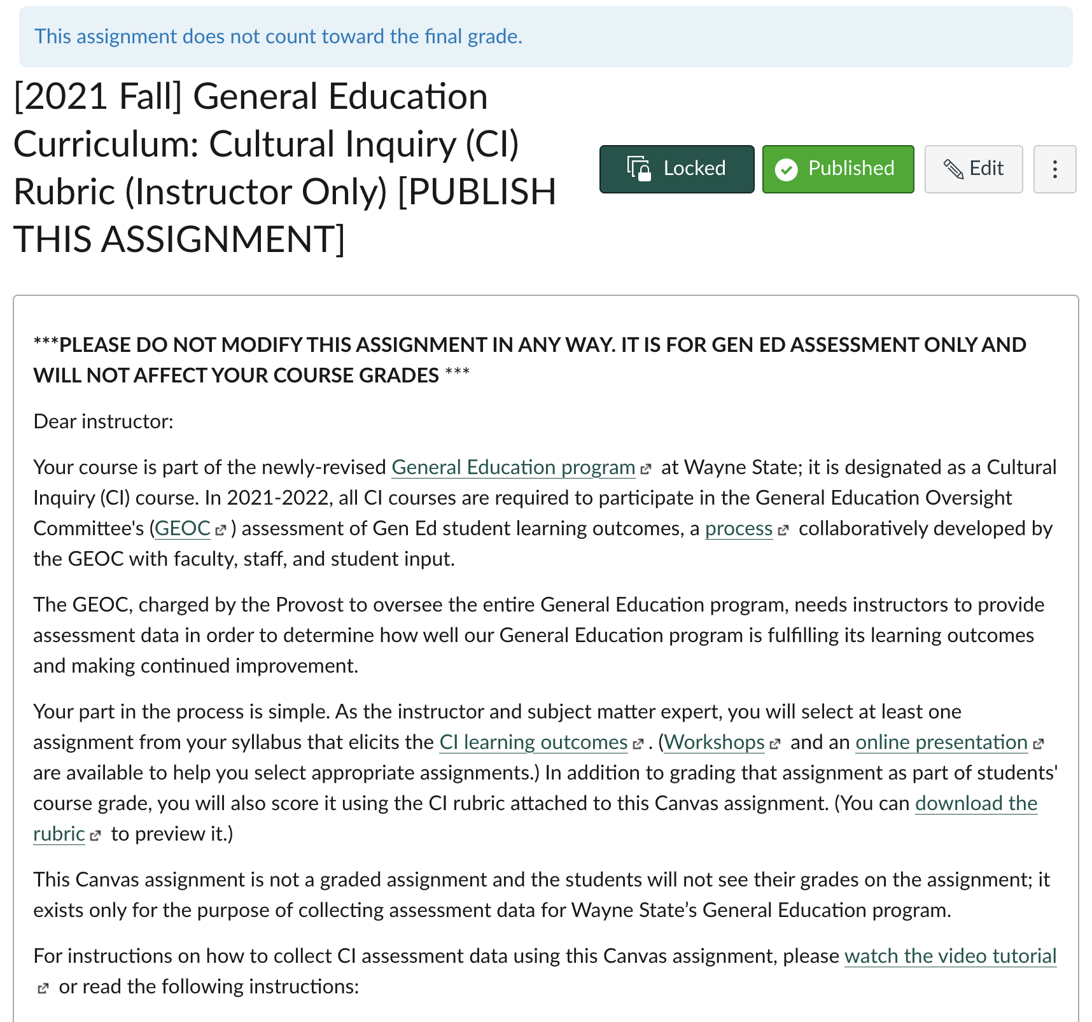
Canvas Assignment Description: Instructor View
Click on the Canvas assignment title to open it.
GEOC has not created an activity for your students to complete.
Instead, the Canvas assignment is just a placeholder. It has instructions for how to use a course assignment for Gen Ed assessment, too.

Slide 20
Use SpeedGrader to Access the Rubric
Click on SpeedGrader within the assignment to use the rubric

Slide 21
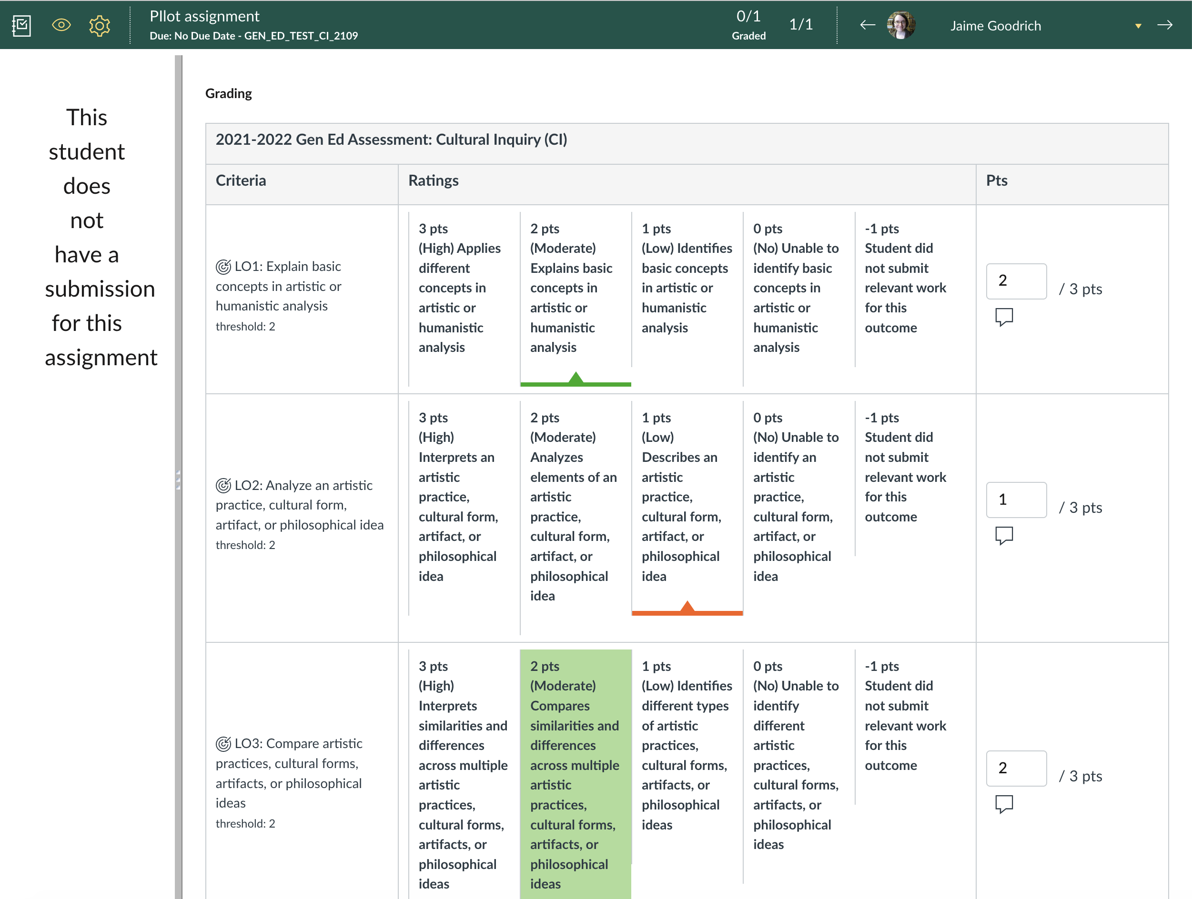
Rubric Display in Canvas Example
Click on the relevant score in the rubric for each outcome. Click SAVE at the bottom of the rubric when you’re done.
This message will appear for every student because they won’t directly attach their work to this Canvas assignment.

Slide 22
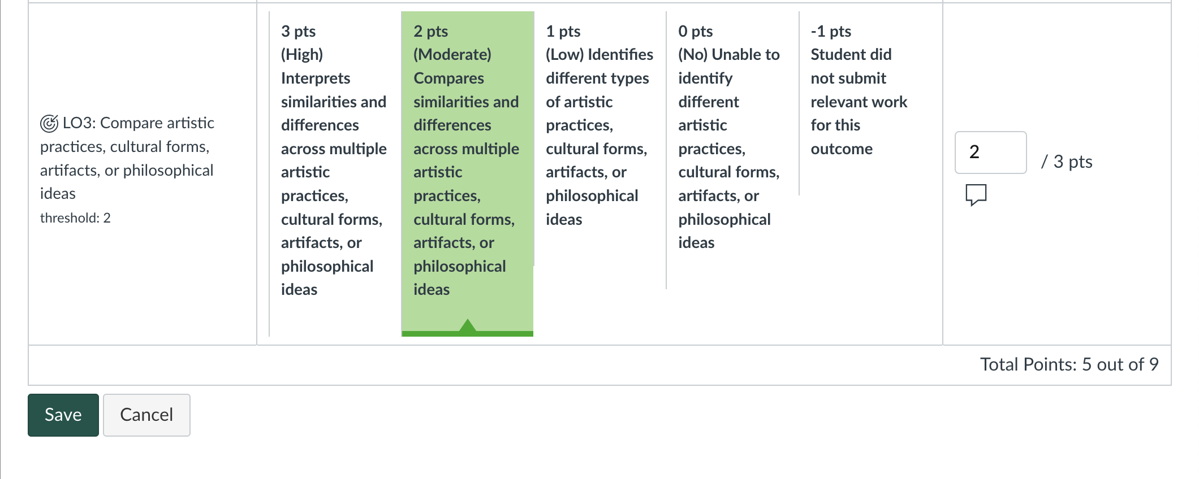
Save after each student; Ignore Points
Points are just default placeholders. They do not affect students’ grades.

Slide 23
Move to the Next Student
Click on the arrow to move to the next student.
When you’re done with the last student, close the SpeedGrader window.

Slide 24
Assignments That Don’t Use Rubrics Pt. 1
Not all courses give assignments that work with rubric scoring. Large classes with multiple choice exams only would be one example.
To address this situation, GEOC has created an alternate assessment option that still uses a course assignment, but is submitted in Excel. To begin:
“Blueprint” your assignment – Which items or sections elicit evidence of each Gen Ed learning outcome at the moderate level or higher?
Example: Final exam questions 1-5 elicit evidence of CI LO 1, questions 6-10 elicit evidence of CI LO2
Out of those items or sections, which elicit at least the Moderate level of the rubric?
Identify a range of scores on the items for each learning outcome that corresponds to each level of the rubric.

Slide 25
Blueprinting/Alignment Example
1. When art historians speak about composition in painting, what are they talking about?
a. the actions and expressions of the figures on the canvas
b. the materials the painting is made with
c. the story being told in the painting
d. the way the figures and objects are arranged on the canvas
2. Which one of these meanings or ideas is NOT covered by the concept of disegno?
a. making art look more naturalistic
b. design
c. drawing
d. turning an abstract idea into art
CI Learning Outcome | High | Moderate | Low | Little to No Evidence
LO1: Explain basic concepts in artistic or humanistic analysis. | Applies different concepts in artistic or humanistic analysis. | Explains basic concepts in artistic or humanistic analysis. | Identifies basic concepts in artistic or humanistic analysis. | Unable to identify basic concepts in artistic or humanistic analysis.
Good question selection, but…
While these questions reach at least the moderate level, having only 2 questions will only result in 3 possible scores (100%, 50% and 0%), so would not correspond to the 4 levels of the rubric.
Be sure to have at least 3 questions per outcome, but more is better!

Slide 26
Assignments That Don’t Use Rubrics Pt. 2
What if none of your assignments can be graded with a rubric (e.g., all assignments are multiple choice tests)?
The next step is to identify a range of scores that corresponds to each level.
e.g., “Moderate” performance = Scores from 75% to 90% on *relevant questions/items
Learning Outcome | (High) Skillfully Converts | (Moderate) Converts | (Low) Identifies | (No) Little to No Evidence
Score range: | 91%-100% | 75%-90% | 60%-74% | <60%
LO1: Explain basic concepts in artistic or humanistic analysis. | Applies different concepts in artistic or humanistic analysis. | Explains basic concepts in artistic or humanistic analysis. | Identifies basic concepts in artistic or humanistic analysis. | Unable to identify basic concepts in artistic or humanistic analysis.
After setting these ranges, convert students’ scores into the rubric levels and submit those results in the Gen Ed Excel template. (e.g. 93% = 3 pts on rubric)

Slide 27
Getting Individual Item Scores from Canvas: Student Analysis Report
Click on the assignment in Canvas
Click on Quiz Statistics
Click on Student Analysis
Use Excel to calculate the number of:
correct answers
students in each score range for the rubric performance levels
Section | Section_id | Submitted | Attempt | Question 1 (ID and stem) | Points possible | Question 2 (ID and stem) | Points possible
Fall 2018 American Govt System Sec 003 | CRN | date/time | 1 | student 1 response | student 1 score | student 1 response | student 1 score
Fall 2018 American Govt System Sec 003 | CRN | date/time | 1 | student 2 response | student 2 score | student 2 response | student 2 score

Slide 28
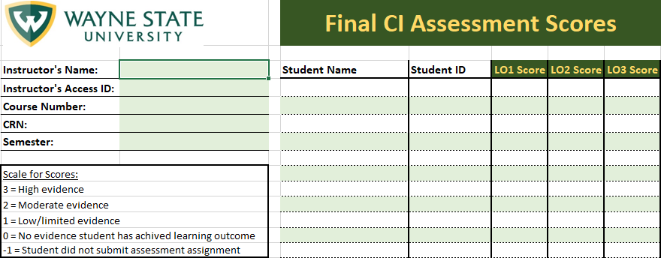
Submitting scores in Excel
Use the GEOC Excel template to report your assessment data.
Instructions in tab 1
Contact gened@wayne.edu to request the template or ask questions.

Slide 29
What Happens to your Data
Institutional Research pulls data from Canvas and creates two reports:
University-level/GEOC report by Gen Ed designation (public)
Aggregated performance by learning outcome across all courses in a given designation
Participation rates by course (% of sections that submitted data)
Confidential instructor-level reports
Shared directly by email with instructor only per the General Education Oversight Committee Data Management Plan
Not shared with instructors’ supervisor, chair, dean, etc.
Cannot be required for any evaluation process, but can be optionally provided by instructor
Displays performance in course section next to performance for all courses and sections in the same designation

Slide 30
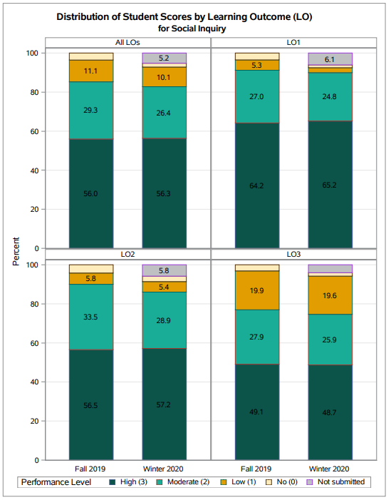
GEOC Report EXAMPLE

Slide 31
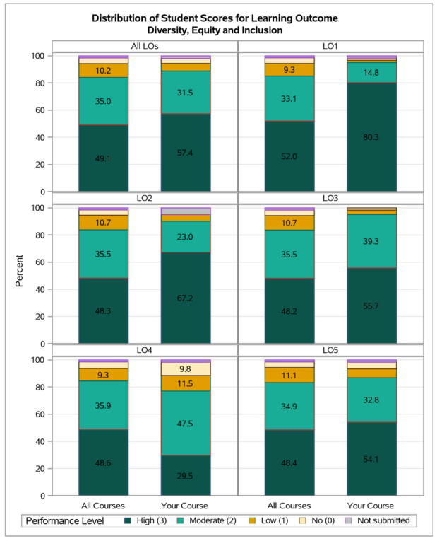
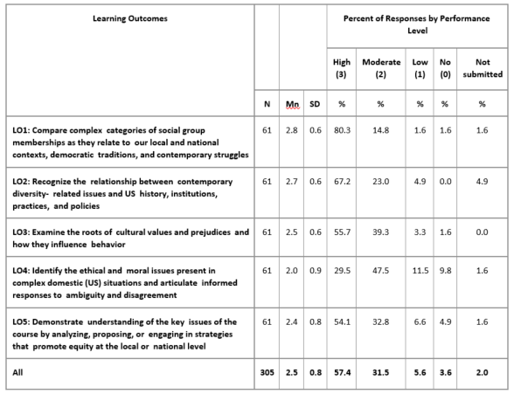
Instructor Report Example

Slide 32
Want Feedback or More Help?
You can request individual feedback or a consultation!
General Education Assessment (Email: gened@wayne.edu)
Office for Teaching and Learning (otl.wayne.edu)
The General Education Program Assessment website has information about other aspects of assessment as well.
As of August 30th you should also be able to access resources on the new Gen Ed website: https://engaginggened.wayne.edu
All CI and GL instructors for 2021/2022 will be added to a Canvas training course for Gen Ed assessment where you will be able to access this information.
Questions about Canvas should be directed to lmsadmin@wayne.edu.

